Slide 1
Canvas Apps
UX & UI
(User Experience & User Interface)
Collection of rules, tips and useful links

Slide 2
UX and UI definitions

Slide 3
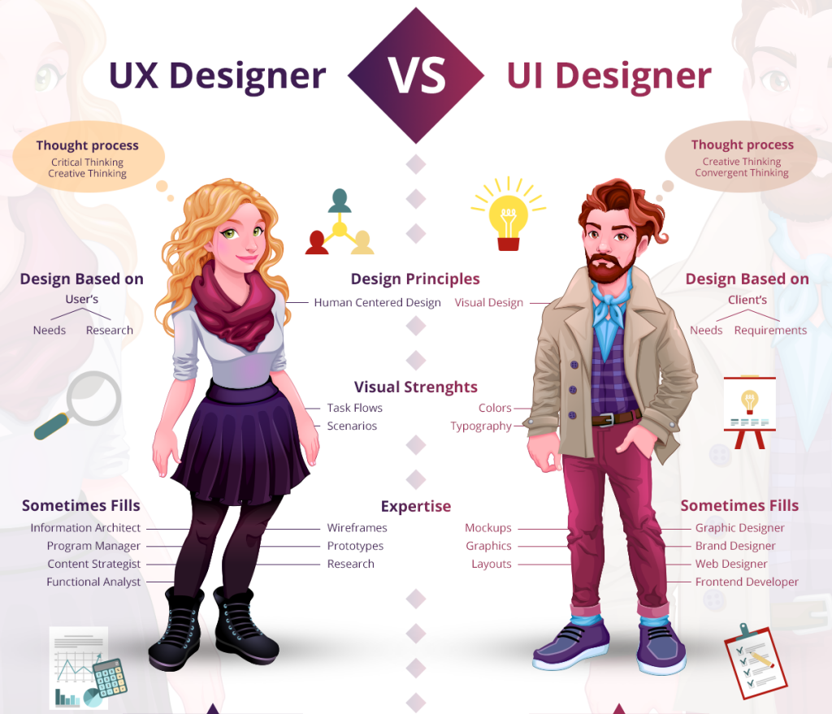
UX vs UI
User Experience
The International Organization for Standardization (ISO) defines user experience as: “A person's perceptions and responses that result from the use or anticipated use of a product, system or service.”
UX refers to the overall experience to address:
How intuitively users can navigate through the system or app.
How easily they can find what they looking for.
How long does it take them to get there
The cues that help guide them to their goal.
The visibility of the essential aspects of a task at the appropriate time.
User Interface
UI is a specialised subset of UX. UI consists of elements like: page layout, colour scheme, font selection, interactive elements and navigation.
User interface design considers the overall look and feel of digital product experiences you're creating, and applies usability and interaction design principles to all product functions and interactive features.
“UX is focused on the user’s journey to solve a problem; UI is focused on how a product’s surfaces look and function.”

Slide 4
Key elements of UI
Page layout
App screen should seem intuitive to users. To organise it that way, you need to make dozens of well-considered decisions—from the header position to the amount of white space.
Color scheme and font selection (typography)
Carefully choose the colours and fonts to ensure consistency, accessibility, and brand alignment.
Interactive elements
From button design to drop-down menus, style your app and screens to make user flows intuitive.
Input controls
Allow the user to communicate with the product by entering information. Input controls can be as simple as a button or checkbox. Some are more complicated, including dropdown menus, toggles, and text fields.
Informational components
Allow the product to provide information to the user. Icons, notifications, progress bars, and tooltips are all familiar examples of informational components.
Navigation
Navigational components help the user find their way through the product. Wayfinding elements like sliders, search fields, tags, and breadcrumbs all facilitate user engagement for a seamless experience.
Containers
Use containers to keep the user interface organised, grouping similar elements. Containers also set a maximum width for content to be displayed, depending on the user's screen size. Headers, tabs, and accordion menus are just some of the containers you’ll see.

Slide 5
Approach to UX
Understand target audience
Discover what users like, and what problems and pain points they’re facing. Ask yourself: “How does this impact the user?” Tip: create user personas.
Put the user first
App designs are successful if they are intuitive and don’t even need training or tutorial. You can achieve this by:
Relying on familiar patterns and practices
Making it easy to undo changes or fix mistakes
Removing distractions
Ensuring users receive timely feedback about their actions
Information architecture
Use visual blueprint, outlining essential navigation, content hierarchy, features, and interactions. Use flowcharts to map out key user flows and decision points. Understand at a glance how the product is intended to work—and where there's a gap that may require additional features or updates.
Wireframes and prototypes
With the information architecture sketched out, start turning ideas into tangible models, such as wireframes and prototypes. Use these proofs of concept to test ideas, define requirements, and set feature priorities. Facilitate collaboration among designers, developers, and product owners, bringing everyone together to produce a more responsive, accessible, usable, and engaging end product.
Testing and troubleshooting
Use product mockup tools or a semi-ready Canvas App to showcase how features will work in practice. If testing reveals issues like confusing navigation, menus, or forms, adjust them before launch.
Ongoing updates
Even after the app launch, your job might never be truly done. With new user feedback and back-end analytics, consider new design updates and improvements.

Slide 6
Canvas apps UX practical tips (1/2)
Think about how to create a good first impression.
Minimise unnecessary noise, and emphasise necessary elements.
Do not add elements that do not support user tasks.
Use visual hierarchy – the eye is “guided” on the interface so it catches the elements in order of their importance.
Use variation in scale, colour, spacing, placement, and other signals.
Think about what will be quick to use.
Minimise the number of clicks/”taps”.
Consider when pagination vs scrolling will work better.
Think about the type of fields – the options set require 2 clicks, while the toggle button is a single move only.
Use HTML components to introduce modern and fresh design.
Duplicate screens rather than creating one from scratch to ensure consistency of component placement. Alternatively, use variables to define positions and sizes.
Select multiple components and “Align” them – either left, right, centre, top, middle or bottom.
Group similar elements together.
Perform data validation to ensure a form is properly filled in before submission. Check that
Required fields are not blank
Proper formatting for phone numbers, email addresses, postcodes, URLs, dates, etc.
Number fields are within the allowed minimum and maximum range

Slide 7
Canvas apps UX practical tips (2/2)
Implement error handling – when an error occurs, notify the user that the form could not be submitted and why it was not successful.
Protect against loss of unsaved data by preventing users from accidentally exiting a form. Before a user leaves the screen and loses unsaved data, prompt them for confirmation.
Ensure that you are also addressing accessibility aspects as part of the app and UX design. Refer to the Microsoft guidance on this subject (links included in the “Resources and references” section.
When a gallery has no data to show, communicate the reason of that to the users – e.g. no results found. Additionally, include guidance on what actions to take next like “create a new record” or “refine filter”.
If the galleries will be used to retrieve large volumes of data, introduce the option to filter the data or/and to use different pre-filtered Dataverse views.
Introduce default sorting of the gallery using either names or dates. Consider also implementing the sort order option to give users the ability to change the default sort if needed.
If you worked with the model-driven apps, check how the views functionality works and try creating a similar experience for the users. That can especially improve the UX if the users are already using model-driven apps. That will ensure the consistency and familiarity of the experience.

Slide 8
Universal design 7 key principles
Equitable use: The design is useful and marketable to people with diverse abilities.
Flexibility in use: The design accommodates a wide range of individual preferences and abilities.
Simple and intuitive use: The use of the design is easy to understand, regardless of the user’s experience, knowledge, language skills, or current concentration level.
Perceptible information: The design communicates necessary information effectively to the user, regardless of ambient conditions or the user’s sensory abilities.
Tolerance for error: The design minimizes hazards and the adverse consequences of accidental or unintended actions.
Low physical effort: The design can be used efficiently and comfortably and with a minimum of fatigue.
Size and space for approach and use: Appropriate size and space is provided for approach, reach, manipulation, and use regardless of the user’s body size, posture, or mobility.

Slide 9
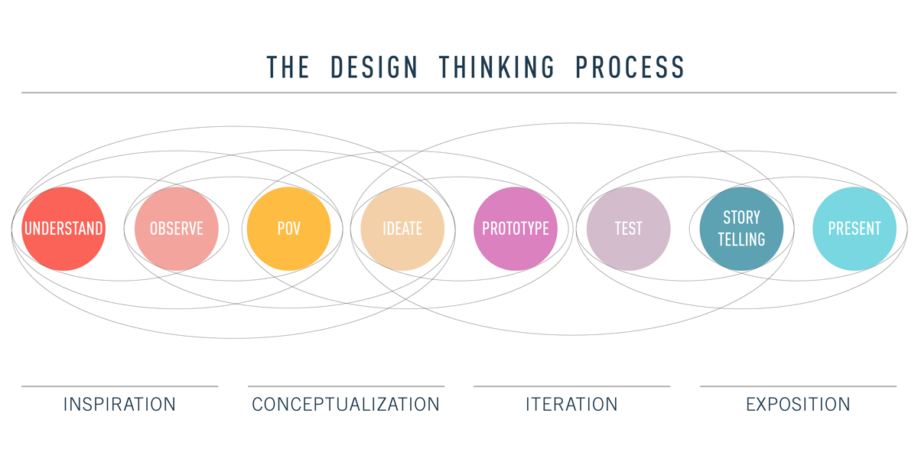
Design thinking process
Term | Definition | Term | Definition
Understand | In order to solve a problem, you need to understand a problem. This first stage in the design thinking process is all about taking the initial steps towards understanding the problem at hand. | Prototype | This is the experimental stage of the process. Transform your ideas into a physical format so that they can be experienced and interacted with by others. Build wireframe after wireframe, then turn them into interactive prototypes (after receiving feedback, of course). Throughout this process, additional insights and empathy-building will occur.
Observe | In this second stage of the Design Thinking process, you'll be performing user research in order to observe your potential users and determine their needs and goals. User interviews and surveys fall under this stage. | Test | In this stage, you'll be testing your prototypes with real users, collecting feedback, then improving and iterating on your designs again and again. Validating your designs in the early stages is a great way to solve problems before they reach a product development team. Use observations and feedback from people to create new hypotheses before starting the process over.
POV | In this stage, your goal is to step into the shoes of your users and "see" your product from their point of view. This is the reason why we create design personas! The closer we can get to our users, the greater our chance of fulfilling their needs efficiently. | Tell Story | As designers, we oftentimes must justify our design solutions to colleagues, managers, and stakeholders. This step is all about explaining and defending design decisions via effective storytelling while still being open to critique and feedback.
Ideate | Now that you've collected all these observations, it's time to make ideas out of them. This is the part of the creative process that allows you to explore a wide variety and large quantity of diverse possible solutions. The purpose of ideation is to move beyond the obvious in order to explore a full range of ideas. User flows/journeys and card sorts fall under this category. | Present | This comes after you've prepared all of your research, design solutions, and prototypes and are confident that your design is ready to be handed off to developers. Your goal at this point is to communicate what developers should code based on your blueprints.

Slide 10
UX psychology and laws

Slide 11
Maslow’s hierarchy
The pyramid shows Maslow’s hierarchy adapted to design (by Aaron Walter).
It demonstrates what elements should be included in the experience in order of their importance:
Functional
It needs to perform the basic task it promises to do by existing. If it doesn’t function, it will not meet the core needs of its users.
Reliable
If it is functional, but only some of the time, then it can technically be used, but not on a consistent basis.
Usable
It may sound like functional, but there are core differences that make this category higher on the hierarchy of user needs. Usable means that a product is easy to learn, discover, and utilise. A user shouldn’t have to search for functionality; it should not require much effort to operate.
A usable product is one that not only works but works well.
Pleasurable
It is not enough for products to work well to reach this level of satisfaction in the hierarchy of user needs. They must be delightful to use and produce joy. Perhaps they solve a user’s problem well, or they are aesthetically enjoyable to use. They have such a deeply satisfying user experience that users are not only able to use the product well, but they also have a good time doing so.
pleasurable
functional
usable
reliable

Slide 12
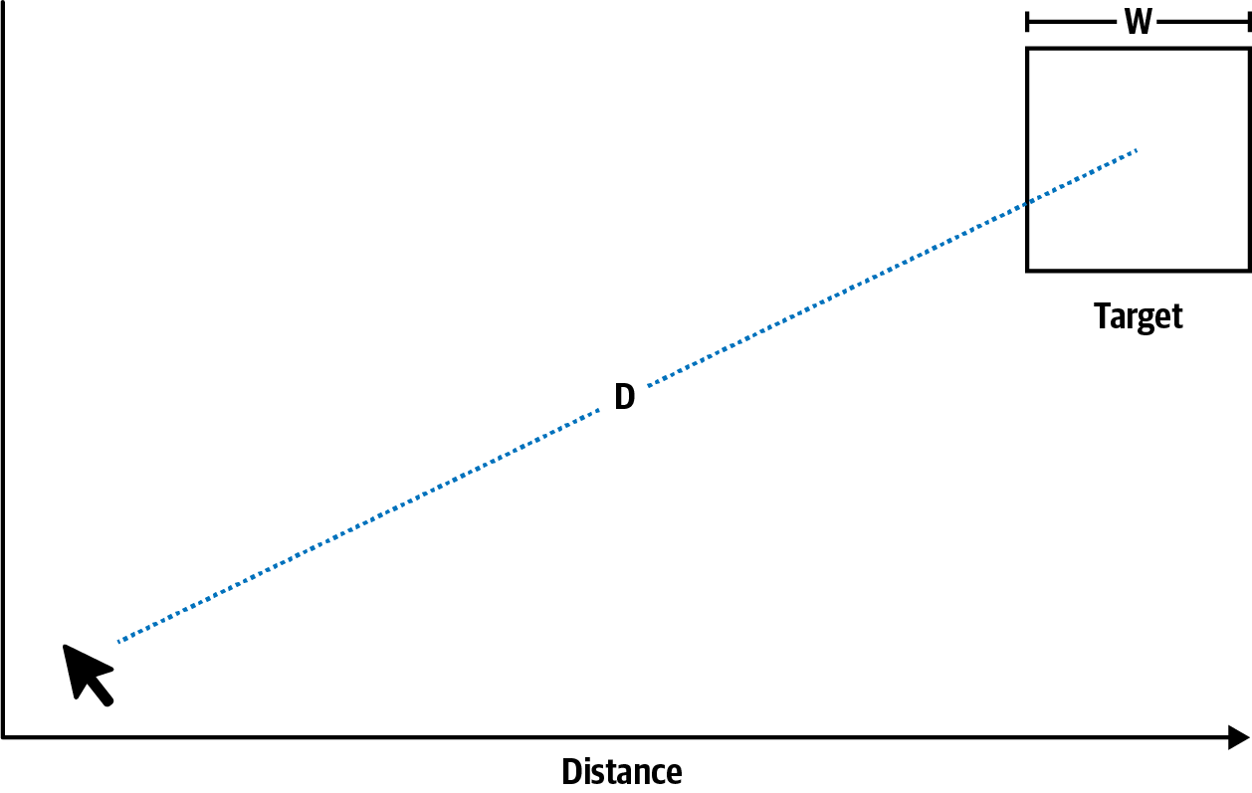
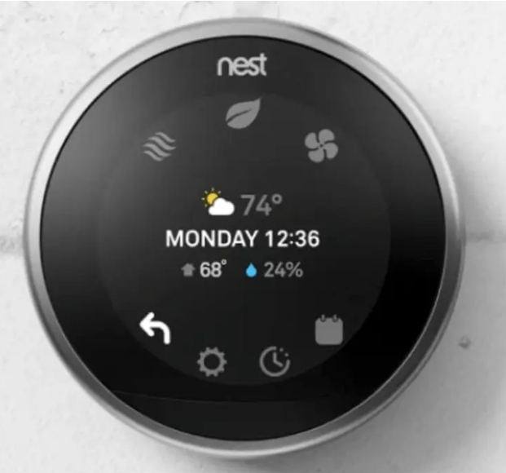
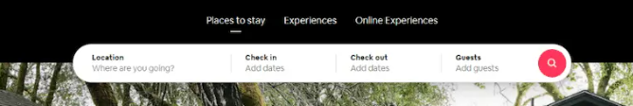
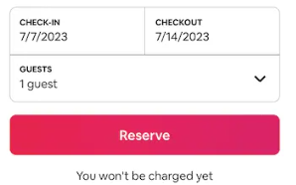
Fitts’s Law
Theory
Examples
The further away a target is and the smaller the size of the target, the longer it takes for a user to acquire.
The Nest thermostat is a shining example of Fitts’s law.
According to this predictive model, pie menus are more efficient. However, this principle is largely ignored in favor of easier-to-design linear menus.
Nest embraces the pie menu in their device’s interface.
With just two gestures, a user can operate the entire unit with very little interaction cost, despite its compact size.
Practical approach
A button to complete an action that is close to the active elements.
Important elements that are made larger so that they’re easier to select.
Interactive lists that are as short as possible.
The shortest path to the desired CTA (call-to-action)
Menus are in the top corners of the screen on desktops and the bottom of the screen on mobile
Airbnb centers its search form, keeps the search function next to the search form, and incorporates a magic pixel menu.
Airbnb continues to use Fitts’s law throughout their website—including in the size and colour of the “reserve” button shown here.

Slide 13
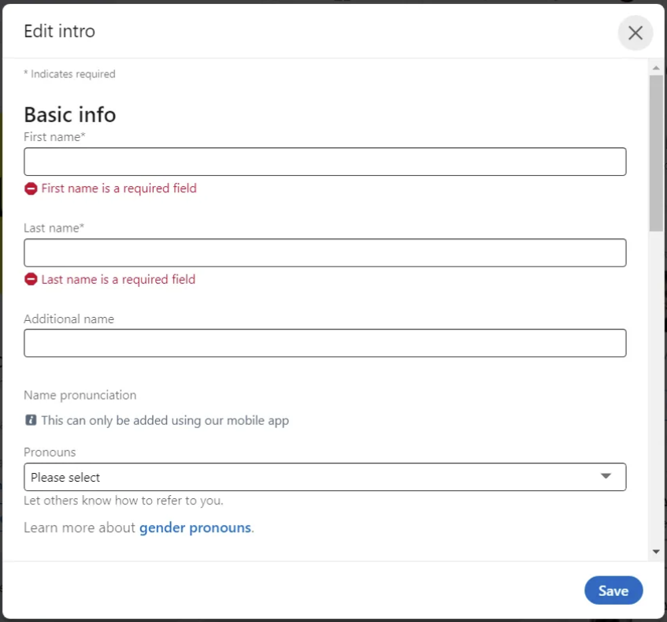
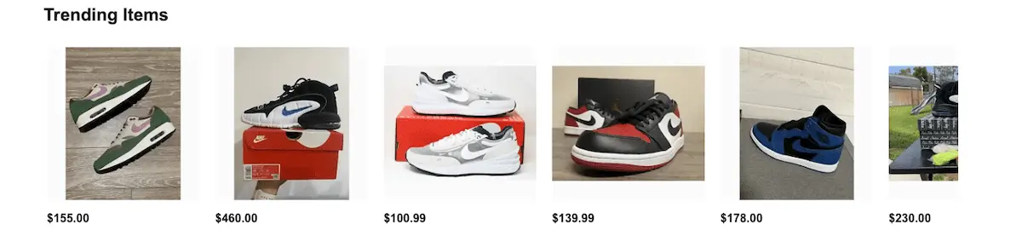

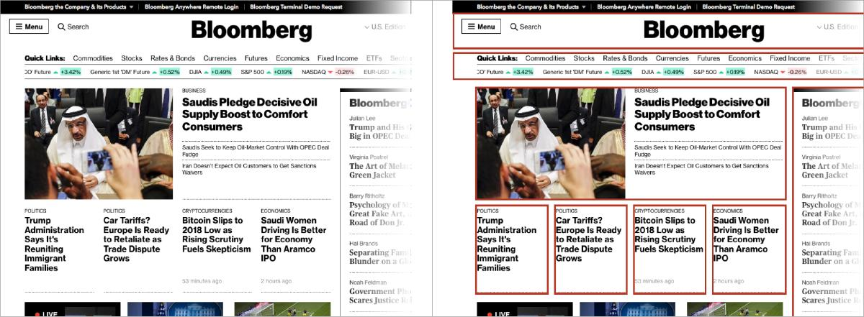
Miller’s Law
Theory
Examples
The average person can only keep 7 (plus or minus 2) items in their working memory.
Contact forms on are a prime example of Miller’s Law in action. Designers must strike a balance between collecting essential information and overwhelming users with too many fields. For instance, LinkedIn’s registration form asks for minimal information upfront: name, email, and password.
Practical approach
Don’t use the “magical number seven” to justify unnecessary design limitations.
Organize content into smaller chunks to help users process, understand, and memorize easily.
Remember that short-term memory capacity will vary per individual, based on their prior knowledge and situational context.
Dynamic menus, image carousels, and virtual carts all call on the brain’s ability to learn, navigate, and stay on task to achieve an end goal.
eBay minimises the cognitive load and decision paralysis. Despite the huge number of items up for auction, the homepage item gallery stubbornly refuses to expand beyond six images.
Overcrowded menus with numerous options can confuse users. Platforms like WordPress simplify their menus by categorizing options under logical headings, ensuring that users can access essential features without feeling overwhelmed.
Bloomberg website uses chunking that helps to organise content to help users process, understand, and memorize easily.
Chunking can be used to help users understand underlying relationships by grouping content into distinctive modules, applying rules to separate content, and providing hierarchy.

Slide 14
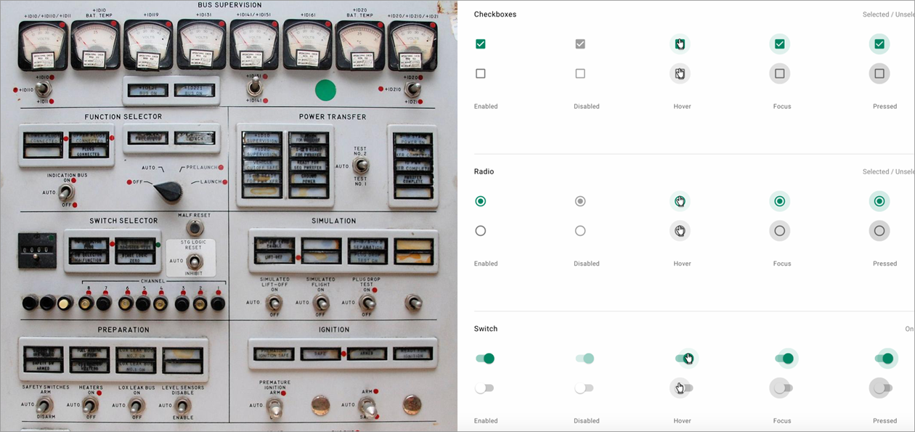
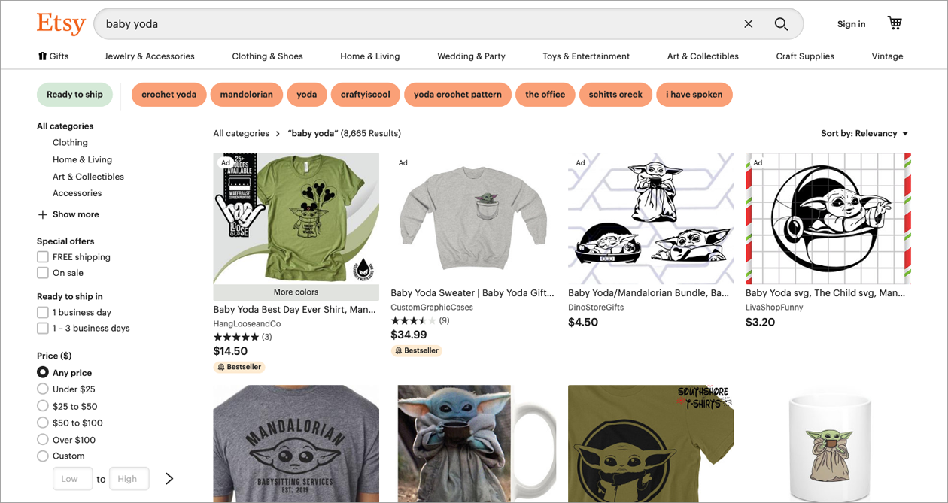
Jakob’s Law
Theory
Examples
Users spend most of their time on other sites. This means that users prefer your site to work the same way as all the other sites they already know.
Have you ever wondered why form controls look the way they do? It’s because the humans designing them had a mental model of what these elements should look like, which they based on control panels they were familiar with in the physical world. The design of elements like form toggles, radio inputs, and even buttons originated from the design of their tactile counterparts.
Practical approach
Users will transfer expectations they have built around one familiar product to another that appears similar.
By leveraging existing mental models, we can create superior user experiences in which the users can focus on their tasks rather than on learning new models.
When making changes, minimize discord by empowering users to continue using a familiar version for a limited time.
Most e-commerce websites leverage preexisting mental models. By making use of familiar patterns and conventions, shopping sites such as Etsy can effectively keep customers focused on the important stuff—finding and purchasing products.

Slide 15
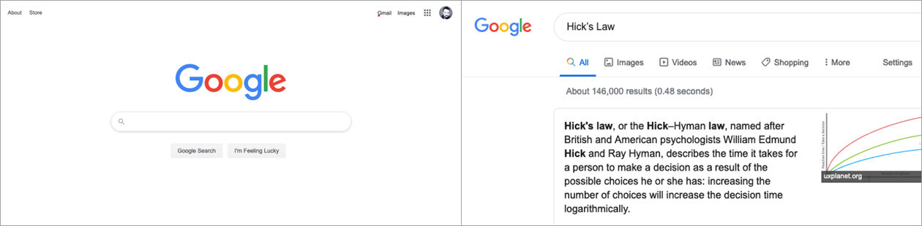
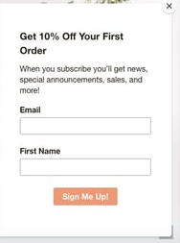
Hick’s Law (paradox of choice)
Theory
Examples
The time it takes to make a decision increases with the number and complexity of choices available.
We can ensure better user experiences by providing the right choices at the right time rather than presenting all the possible choices all the time.
Practical approach
Minimize choices when response times are critical to increase decision time.
Break complex tasks into smaller steps in order to decrease cognitive load.
Avoid overwhelming users by highlighting recommended options.
Use progressive onboarding to minimize cognitive load for new users.
Be careful not to simplify to the point of abstraction.
An excellent example of this can be found with Google Search, which provides the varying means of filtering results by type (all, images, videos, news, etc.) only after you’ve begun your search. This helps to keep people focused on the more meaningful task at hand, rather than their being overwhelmed with decisions at the outset.
Brown and Coconut website provides a great example of an email sign-up form implementing Hick's Law. The user has two clear options: Sign up for emails or exit the form. If they choose to complete the form, they only have to fill in two fields.

Slide 16
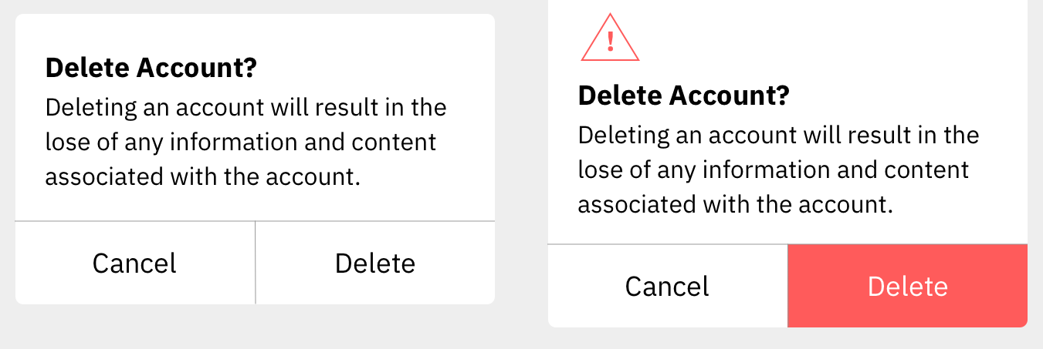
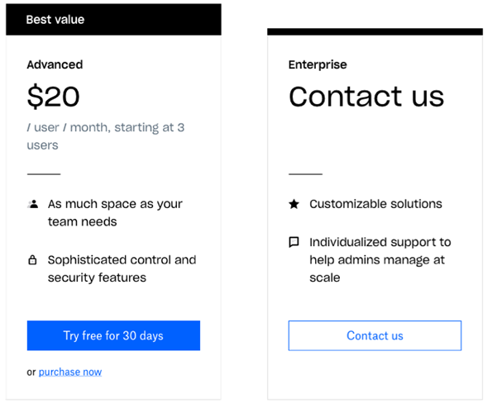
Von Restorff Effect
Theory
Examples
When multiple similar objects are present, the one that differs from the rest is most likely to be remembered.
Compare the two versions of a confirmation modal on the left: one with buttons that are visually indistinct from one another, and another with emphasis placed on the most important button.
Practical approach
Make important information or key actions visually distinctive.
Use restraint when placing emphasis on visual elements to avoid them competing with one another and to ensure salient items don’t get mistakenly identified as ads.
Don’t exclude those with a color vision deficiency or low vision by relying exclusively on color to communicate contrast.
The lack of visual contrast in the modal on the left could easily lead to people accidentally selecting the wrong action. By placing a visual emphasis on the destructive action, the version on the right will not only help guide users who want to delete their accounts to the correct option but will also help those who don’t intend to delete their accounts avoid accidentally selecting this option.
Often companies will emphasise one subscription option over the others. To achieve this emphasis, designers frequently differentiate the options they want to call out by adding visual cues. The example on the left (Dropbox) shows an emphasis on the “advanced” option through the use of colour (an accent colour is applied to the “Try free” button), shape (the card appears slightly larger due to the “Best value” element at the top), and position (placing the card in the centre of the display).

Slide 17
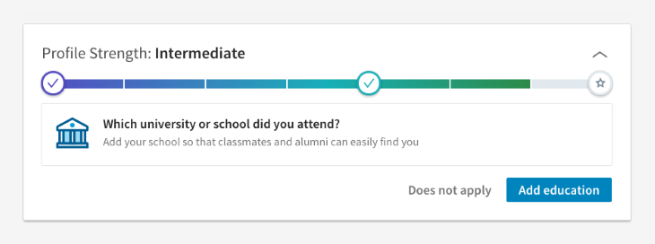
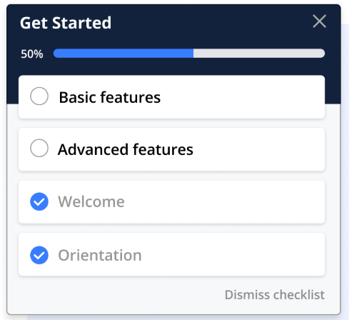
Goal-Gradient Effect
Theory
Examples
The tendency to approach a goal increases with proximity to the goal.
Progress bar is widely used a visual indicator to show users how far along they have gotten through a journey. They offer a tangible perception of moving forward, which effectively triggers the goal gradient effect. As users complete tasks, the progress bar fills up. This motivates them to continue striving for their goals until the progress bar is filled.
Practical approach
The closer users are to completing a task, the faster they work towards reaching it.
Providing artificial progress towards a goal will help to ensure users are more likely to have the motivation to complete that task.
Provide a clear indication of progress in order to motivate users to complete tasks.
Checklists can also motivate users to stay on track.
The goal gradient effect can encourage desired behaviors by bringing in rewards or incentives that tempt users to act in a specific way. For instance, think of a language learning app. It might reward users every time they finish a lesson. This nudges them to keep learning, driven to hit the next milestone.
Animated progress bar in Power Apps
https://www.charlessexton.com/blog/animated-progress-bar-in-power-apps

Slide 18
Complexity of simplicity
Simplicity is a difficult concept to quantify and define. Its subjectivity stems from its multiple meanings; it can refer to how “clean” the design is, the complexity of the build, how intuitive it is or how many features are included.
One potential definition defines simplicity as “serving users what they need when they need it in the most straightforward way possible“
The more things there are to consider, the harder it can be to keep things simple, and yet the greater the need to keep things simple is!
What are the arguments for keeping things simple?
People have much shorter attention spans today
Simple is more convenient for the user
Complicated products are likely to have more feature creeps
Simple is often more enjoyable
Looking at these various reasonings, it’s no wonder, then, that the KISS principle (Keep It Simple, Stupid) is so important to UX design today. But are there reasons why you would want to avoid simplicity in design?
Simple is not necessarily easy to use
Sometimes more features are needed
Simple is not always the best way to engage the user
Over-simplified products sometimes provide poor user experiences

Slide 19
Desktop vs mobile vs tablet consideration

Slide 20
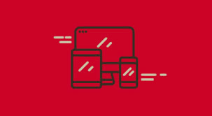
Responsive design
Before you build a canvas app in Power Apps, specify whether to tailor the app for a phone or a tablet. This choice determines the size and shape of the canvas on which you'll build your app.
Make sure that you know exactly who will be using the app and on what devices.
One approach is to implement a responsive layout. However, it might be more complicated to do it and also to apply the "thumb zone“ theory (more on the next slides).
Alternative is to create separate apps that are tailored for use on a single device.
On some occasions, that won’t be an issue at all as the Canvas App will be only ever used on desktop.
Microsoft resources on the responsive design: https://learn.microsoft.com/en-us/power-apps/maker/canvas-apps/create-responsive-layout
Responsive design video tutorial (from Reza Dorrani): https://www.youtube.com/watch?v=1o2L0DADzKQ
TrulyResponsive – The framework to create responsive Canvas Apps (from Ilya Fainberg): https://github.com/Feincraft/TrulyResponsive

Slide 21
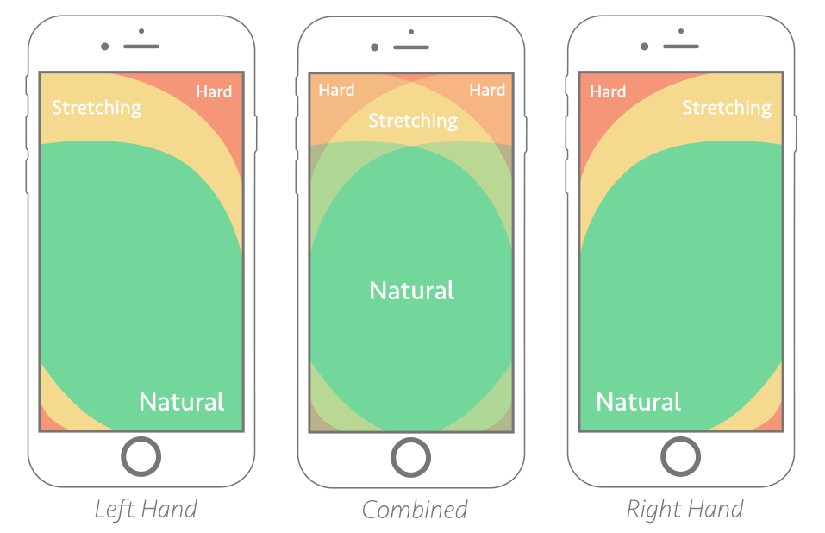
Mobile
On phones, the best interfaces are optimised for a one-handed grip, because it’s at once the most freeing and the most limiting. It’s freeing because it lets the users do things with the other hand—write or sip coffee — a fact that makes it the most common grip. But it’s limiting because working a phone one-handed means working it with a thumb.
The consideration of the "thumb zone“ is a term coined in Steven Hoober’s research, an important factor in the design and development of mobile interfaces.
Certain zones for thumb movement apply to most smartphones (see the picture on the right).
They are defined as easy-to-reach, hard-to-reach and in-between areas.
Thumb-zone mapping for left- and right-handed users. The "combined" zone shows the best possible placement areas for most users.

Slide 22
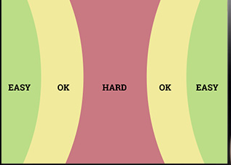
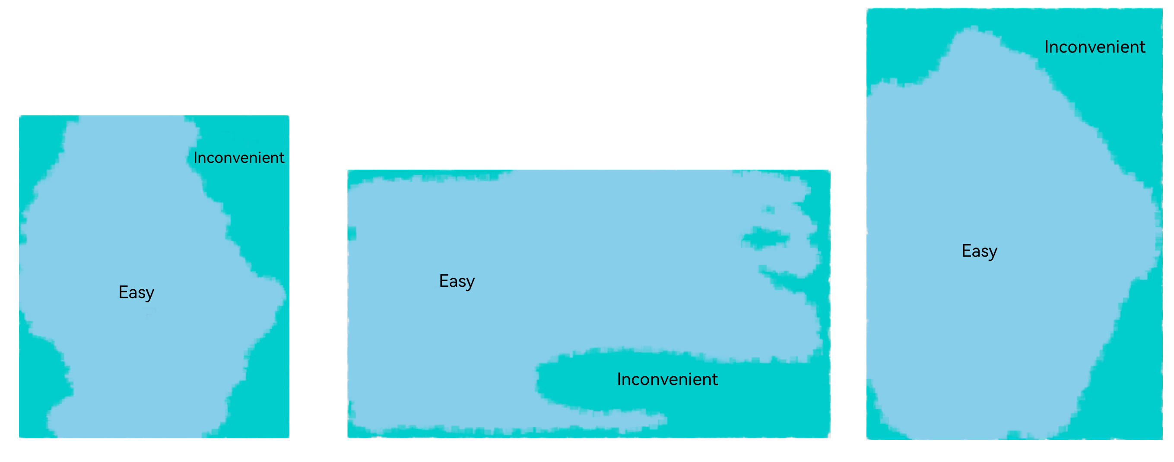
Tablets
The tablet size (greater than 8 inches) is large and cannot be held with one hand. Based on research and analysis of human factors, the following two methods are usually used to operate a tablet:
Users hold the tablet with one hand and operate it with the other hand. In this case, the operation area is large and users are easy to operate except for the holding area (shown below).
Users place the tablet flat on the desk or put it on the holder and tap to operate it. In this case, users can easily operate any area on the tablet screen without obstacles.
Based on the analysis, there is no restrictions posed by the tablet operation area on the display layout.
For smaller tablet devices, it is worth considering the most comfortable touch areas as shown below.
However, in general, tablets are trickier because we hold them so many different ways. We grab, tilt, lean, cradle, and clench in a whole variety of embraces, many of which depend upon stance.
The rule of thumb still applies to these guys, except that the thumb zone changes.
Tablet navigation and other frequent controls should hug the sides or top corners for easy thumb access. Avoid forcing people to lift and haul their entire arms over to the top or bottom edges for frequent touch targets. Some arm lifting is of course inevitable.
Tablets are thumb and index-finger devices, with the index finger driving interaction inside the tablet’s canvas.
The top corners are within thumb striking distance while also remaining in the tablet’s primary visual area.

Slide 23
Colours, gradients & HTML components “-phisms” (glassmorphism , neumorphism, claymorphism)

Slide 24
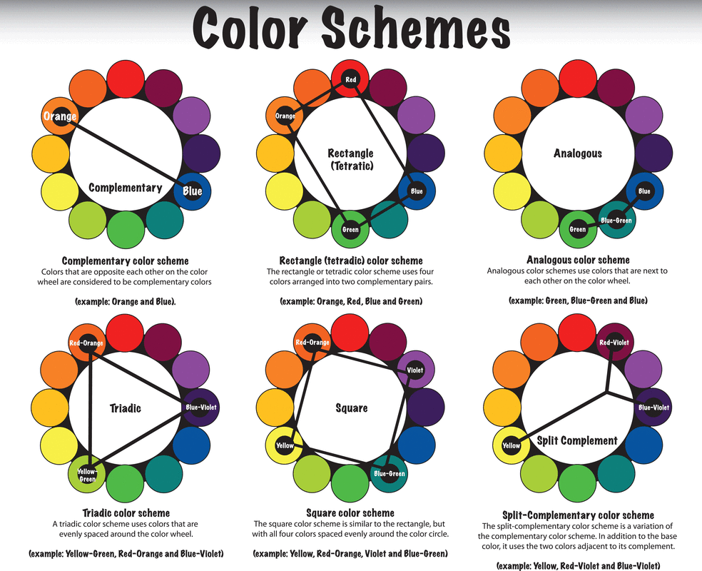
Colour Harmony
Use the Colour Wheel to find colour combinations that work the best.
There are 6 colour scheme combinations to use as shown on the diagram.
Simple Colour Wheel: https://www.canva.com/colors/color-wheel
Advanced Colour Wheel: https://color.adobe.com/create/color-wheel
Color Conversion in Power Apps https://www.charlessexton.com/blog/color-conversion-in-power-apps

Slide 25
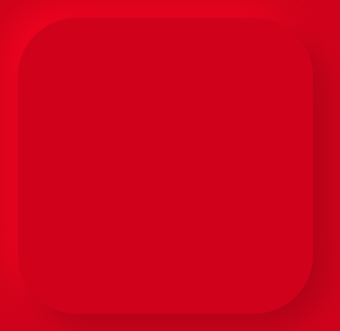


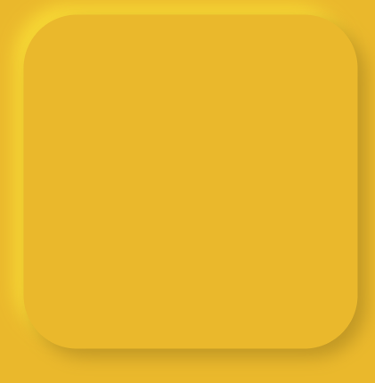
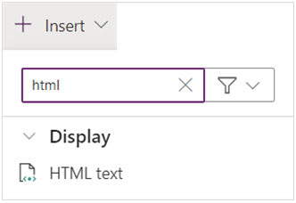
HTML component
HTML Text Component can be used in Canvas Apps to apply CSS.
That allows creating of box shadows, 3D effects and effects like glassmorphism, neumorphism, claymorphism.
The HTML components with these effects can be used as backgrounds, buttons or gradient text.
Add “HTML Text” component via Insert menu as shown below:
Microsoft logo created using glassmorphism effect

Slide 26

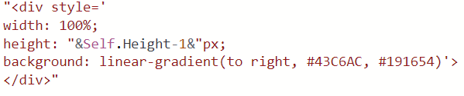
Gradient
Gradient is a progressive transition between two or more colours.
You can achieve that by adding the below to your HTML component code:
background: linear-gradient(position, #colour1, #colour2)
Find and test gradients here https://uigradients.com
Find HEX code for colours: https://htmlcolorcodes.com/color-picker
Use Chrome extensions like Colour Picker to find colours from a company website or logo. https://chromewebstore.google.com/detail/color-picker/plkgncpmcodceeghncefaiohiekknelh?pli=1
More about the gradient function: https://developer.mozilla.org/en-US/docs/Web/CSS/gradient/linear-gradient
Gradient text in Canvas App turtorial: https://www.youtube.com/watch?v=UJ2HaPGuGZs
Example
replace “position” with to top, to bottom, to left, and to right or angle value (e.g. 45deg, 180deg)
replace #colour1 and #colour1 with own colours
add multiple colours, just separate them with “,”

Slide 27
HTML component
Style | What is it? | CSS Generators | Online resources
Glassmorphism | “Frosted glass” effect in the UI. | https://hype4.academy/tools/glassmorphism-generator | Glassmorphism best practices tutorial (from MalewiczHype): https://www.youtube.com/watch?v=gg8ki_rjceo Glassmorphism in Canvas Apps tutorial (from Kristine Kolodziejski): https://www.youtube.com/watch?v=UZ-kHjhqbW0
Neumorphism | Soft and light look, often using pastel colours with low contrast. | https://hype4.academy/tools/neumorphism-generator https://neumorphism.io/#e0e0e0 | Neumorphic UI Kit for Power Apps: https://www.youtube.com/watch?v=O4238tRgMtQ Neumorphic UI Kit Silver: https://github.com/misskristine94/NeumorphicUIKitSilver
Claymorphism | Inflated, fluffy 3d shapes and artwork in user interfaces. | https://hype4.academy/tools/neumorphism-generator | Claymorphic Mobile Navigation Menu: https://github.com/misskristine94/ClaymorphicMobileNavMenu Claymorphism Tutorial: https://michalmalewicz.medium.com/claymorphism-tutorial-5acc4c91a440

Slide 28
Iconography & typography

Slide 29
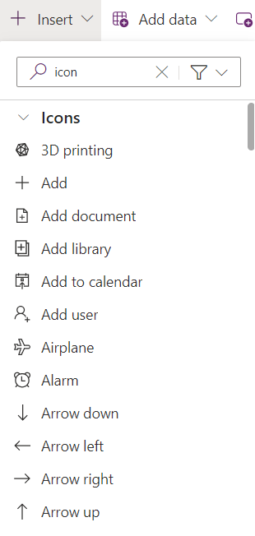

Iconography (aka icons)
Iconography refers to the use of icons, which are simple, recognisable symbols created to communicate a message.
There are multiple icons that we collectively understand with no additional context – see the example below:
There are several reasons why the use of icons might have advantages over text in app design:
Simple, bold, and friendly, they can replace a long (and usually boring) descriptive group of words.
They save space on the screen and as screens get smaller, this is much welcomed.
Visually pleasing, they can also enhance the aesthetic appeal of a design.
Last but not least, most apps use icons, it’s a design pattern which is familiar for the users.
Canavs Apps come with a rich library of icons that can be used when building a new app.

Slide 30
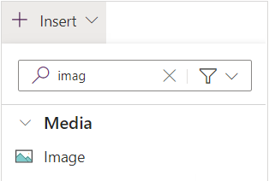
Custom icons
In addition to the icons library, new SVG icons can also be added to the Canvas Apps.
Start by adding an Image from Insert menu, then add CSS code to it.
Useful resources and articles:
Intro to SVGs - fundamentals, viewBox and viewPort, animation, gradients and Power Apps https://www.youtube.com/watch?v=5qbZXjRbWIk
How To Show File Type Icons In A Power Apps Gallery https://www.matthewdevaney.com/how-to-show-file-type-icons-in-a-power-apps-gallery/
SVG Images in Power Apps https://www.matthewdevaney.com/svg-images-in-power-apps/#Where-Can-I-Find-SVG-Icons-for-Power-Apps
2,000 Free Power Apps Icons https://www.matthewdevaney.com/2000-free-power-apps-icons/
Open source icon library https://icons.getbootstrap.com/
Syncfusion Metro Studio Icons https://www.syncfusion.com/downloads/metrostudio
SVG Backgrounds https://www.svgbackgrounds.com/
Icon Packs https://elements.envato.com/graphics/icons
Open source 3D icons https://3dicons.co
Icons animation
Animate any SVG image in Power Apps https://www.youtube.com/watch?v=SI1tCOUg1_w
Animate Transform function https://developer.mozilla.org/en-US/docs/Web/SVG/Element/animateTransform

Slide 31
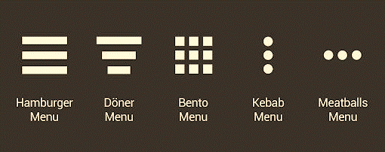
Iconography - menu
Icon | Name | Details
 | Hamburger Menu | The hamburger menu is the most used of all navigation menus and can be found anywhere on the screen. Its simple and useful design triggers curiosity and reveals more by clicking the icon or hovering over it. It is used as a panel sliding from left or right on smaller screens or as a drop-down menu on larger screens.
 | Döner Menu | The döner menu is a variation of the more famous hamburger menu, yet the döner menu is the most commonly used icon in the UI of today. The use case for this UI design element is for filtering items on an app: it opens a dropdown navigation drawer.
 | Bento Menu | The bento menu is a commonly used menu icon everywhere else, too, often seen in the upper right corner of the screen. Like its food container inspiration, a bento menu organises different functions that can be found in the same product. Use it for hig- level navigation, typically for transitioning between apps or modules. Also, the icon is also sometimes called a “waffle” menu.
 | Kebab Menu | The kebab menu is similar in concept to and is inspired by a hamburger menu. However, the hamburger menu is solely used for internal navigation. In contrast, the kebab menu is mainly used for the external navigation or overflow menu.
 | Meatballs Menu | The meatballs menu, also called the ellipsis menu, is mostly used to open up additional options. Meatball menus, once clicked, contain links to related items or related actions not seen on the main screen. It can be used for context menu or to group less commonly used functions.
3.5” floppy is Save, X is Close, ? Is Help.
In addition to deciding on the icon to be used for the menu on your Canvas App, you need to design the navigation itself from the icon. The best approach is to start from creating a navigation tree diagram.

Slide 32
Typography (aka fonts)
Typography is a design discipline that involves the use of typefaces and the organisation of those typefaces to create readable, usable and ideally, user-friendly interfaces or experiences.
Effective typography enhances UX, optimises usability, catches users’ attention and has the potential to increase conversion rates.
Type hierarchy for your app/site is crucial as it allows your users to quickly scan through information. Organize your content according to priority; the most important must be the most prominent and the least important should be smaller and unobtrusive. Size, weight and color are effective ways of creating visual hierarchy.
Keep it simple! Too many typefaces can look sloppy and lead to confusion. It’s best to stick to between two and three typefaces in design. Using multiple typefaces also adds to the size and loading time of applications. For optimizing the experience, use fonts that are likely to be available/installed at the users’ end.
Your typefaces shouldn’t be too similar; otherwise, their nuances will be lost. Create contrast by choosing one serif and one sans serif font.
The text your typography creates needs to be understandable; otherwise, it defeats the purpose of communicating information through text. Consider your user, their environment and the medium with which they’re engaging with your product. Colour and contrast can make or break accessibility.
The prevalence of “dark mode” is a good example with which to illustrate the importance of accessibility—it reduces the discomfort of looking at a bright screen and improves overall legibility (the characters and words of your text are recognisable and easy to comprehend) and readability (your text is easy to follow, overly-complex words and overwrought sentence structures are avoided).
Useful resources and articles:
https://www.matthewdevaney.com/how-to-use-custom-fonts-in-powerapps/
https://www.powernimbus.com/2019/04/using-custom-fonts-in-powerapps/
https://coolsymbol.com/
https://fonts.google.com/

Slide 33
Resources and references

Slide 34
Microsoft resources
Name | Link | Description
Build UI in a canvas app | https://learn.microsoft.com/en-us/training/modules/how-to-build-ui-canvas-app | Microsoft learning module on how to build the User Interface in a canvas app in Power Apps
Creator Kit | https://learn.microsoft.com/en-us/power-platform/guidance/creator-kit/overview | The Creator Kit helps create Power Apps experiences on the web and mobile platforms with convenient components that are ubiquitous in modern software. The kit contains a component library, several commonly used Power Apps component framework controls, a set of templates, and other utilities that increase developer productivity.
Create accessible canvas apps | https://learn.microsoft.com/en-us/power-apps/maker/canvas-apps/accessible-apps | Microsoft guidance on Power Apps accessibility.
Accessibility checker | https://learn.microsoft.com/en-us/power-apps/maker/canvas-apps/accessibility-checker | Guide how to review a canvas app for accessibility in Power Apps
Accessibility limitations in canvas apps | https://learn.microsoft.com/en-us/power-apps/maker/canvas-apps/accessible-apps-limitations | Article about accessibility limitations in canvas apps, and how can you improve the app interface to make it more accessible.
Office design toolkits | https://learn.microsoft.com/en-us/office/dev/add-ins/design/design-toolkits | Office design toolkits for use with either the Sketch application for Mac or the Adobe XD application for Windows or Mac.

Slide 35
Design inspiration resources (free & subscription-based)
Description | Link
Design portfolio platform | https://dribbble.com/
World’s largest creative network for showcasing and discovering creative work | https://www.behance.net
Creative assets for download | https://elements.envato.com/
High resolution images | https://unsplash.com
Mobile and web design library | https://mobbin.com/browse/ios/apps
UI design inspiration | https://screenlane.com
User flows | https://pageflows.com
Design Inspiration & UI Patterns | https://designvault.io/mobile
The framework to create responsiv | https://github.com/Feincraft/TrulyResponsive
App inspo categorised into adding, booking, consuming, creating, deleting, editing account and more. | https://uxarchive.com
The one-stop station for app builders | https://www.theappfuel.com
A collection of UX frameworks for creating beautiful, cross-platform apps that share code, design, and interaction behavior | https://developer.microsoft.com/en-us/fluentui#/

Slide 36
References
Must-Know YouTube Channels
https://www.youtube.com/@KristineKolodziejski
https://www.youtube.com/@charlessexton1483
https://www.youtube.com/@IlyaFainberg
https://www.youtube.com/@PowerPlatformRyan
https://www.youtube.com/@matthewdevaney3912
Blogs & websites
https://kristine.dev/
https://www.charlessexton.com
https://www.matthewdevaney.com/
https://blog.logrocket.com
https://careerfoundry.com
https://www.interaction-design.org
Books
Laws of UX by Jon Yablonski
Don't Make Me Think, Revisited: A Common Sense Approach to Web Usability by Steve Krug
UX Fundamentals for Non-UX Professionals User Experience Principles for Managers, Writers, Designers, and Developers by Edward Stull
The Art and Science of UX Design by Anthony Conta
YouTube useful videos
We Had a UX Designer Fix Our Power App Part 1 https://www.youtube.com/watch?v=rtxBKzReQXA&t=6s
We Had a UX Designer Fix Our Power App Part 1 https://www.youtube.com/watch?v=lmA6KMeNV-M
How to Build Power Apps with Modern Experiences | Beginner's Tutorial https://www.youtube.com/watch?v=exxos1gaLsg

Slide 37
Contact info

Slide 38
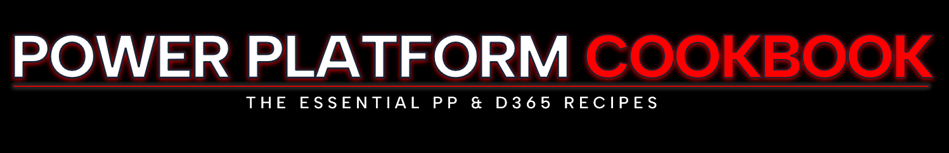

Blog
https://www.ppcookbook.com/
LinkedIn
https://www.linkedin.com/in/anna-black-ppcookbook
YouTube:
https://www.youtube.com/channel/UCbgY5HQUl4L5XaKXe2mu5wA
GitHub
https://github.com/aniablack

